Slide 1
DEVOPS INTRODUCTION

Slide 2
AGENDA
SDLC PHASES
WATERFALL SDLC MODEL
AGILE SDLC MODEL
DEVOPS METHODOLOGY
WHY DEVOPS
DEVOPS PERIODIC TABLE
DEVOPS TOOLS
USE CASE: DARK LAUNCHING
DIFFRENCES ON SDLC’s
CI CD FLOW
DEVOPS SCOPE
SUPPORTIVE DOCUMENTS

Slide 3
SDLC PHASES
REQUIRMENT GATHERING
PLANNING
DESIGN
CODING
IMPLEMENTATION
TESTING
DEPLOYMENT
MAINTAINENCE

Slide 4
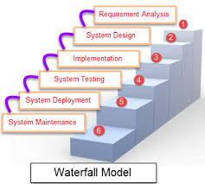
WATERFALL SDLC MODEL
What is WATERFALL
First documented SDLC ,introduced on 1970
Linear Sequential manner or Ladder kind of SDLC Model
Limitations or Challenges
Test result, Bug fixing, Slow in software delivery, No frequent Feedback to developers and notifications, Time consuming
Not portable to Moderate to high risk changes

Slide 5
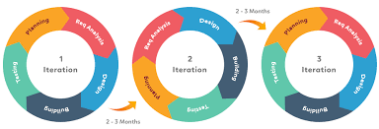
AGILE SDLC MODEL
What is AGILE
Agile is an combination of iterations and incremental process and mainly it focuses on process adoptability and Customer Satisfaction. Agile divides the build into incremental builds and same will be provided to iterations
AGILE MANIFESTO PRINCIPLE
Individual &Interactions; Working Software Copy Demo
Customer collaboration; Respond to change
Cross functional Training and It has only CI; Each Iteration complete in 2-3 months
Final build holds the entire requirement of the customers.

Slide 6
AGILE SDLC MODEL
Advantages
Realistic, Need Min manpower or resource
no planning or zero planning and low doc
Quick response to change or Release & Easy to manage
Cross functional training and Frequent Working copy demo
Disadvantages
Customer Dependency , KT is a challenge due to lack of docs
More risk in maintainability / extendibility, handling complex business solution is challenge
Conflicts and Configuration mismatches
Ops looks stability and Dev looks changes
Real-time challenges
No Continuous deployment
Test result, Bug Fixing, Slow in software delivery, No frequent feedback

Slide 7
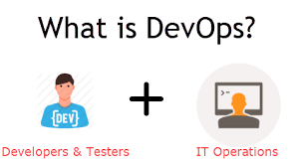

DEVOPS METHODOLOGY
DevOps is an enterprise software development Life cycle means to have an agile relationship between Development and Operation teams and which also act like a bridge between both business units.
=> Automation and tools + AGILE
Set the Roadmap to software delivery
Preferred Skill: Communication, Collaboration and Philosophies
Usage: Enables Organization ability to deliver the high end project
Objective /Goal: Eliminate wastages from Project via CSI [ITIL]

Slide 8
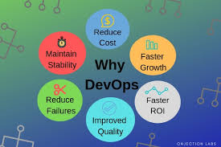
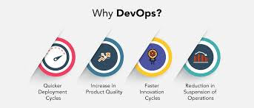
WHY DEVOPS

Slide 9
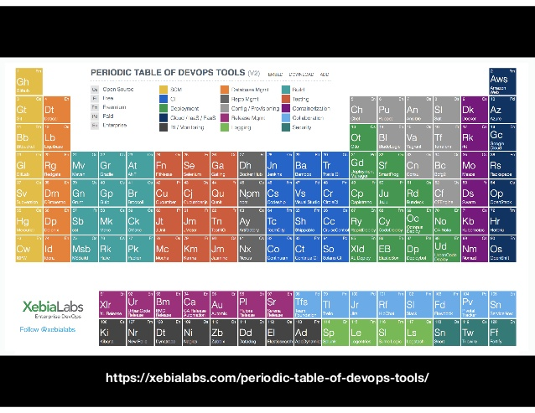
DEVOPS PERIODIC TABLE

Slide 10
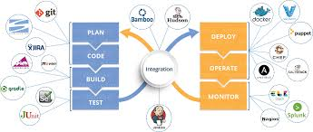
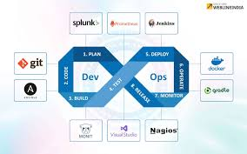
DEVOPS TOOLS
TOOLS WE COVER
GIT – Distributed Version Control System
JENKINS – Continuous Integration Tool
ANSIBLE – Push Configuration Management Tool
SALT STACK – Push and Pull CMT
DOCKER – Containerization [ Deployment tool]
KUBERNETES – Container Management tool
SPLUNK – Monitoring Tool

Slide 11
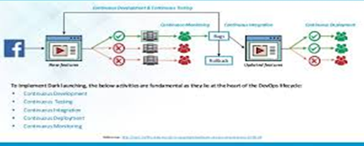
USE CASE: DARK LAUNCHING
SINGLE USER BASE and CI CD
In 2011, Facebook decided to undergo huge change
Single user base Technique
Everything done on a continuous fashion and moved the build to production once all issues recovered.

Slide 12
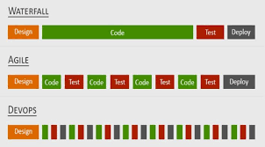
DIFFRENCES ON SDLC’s

Slide 13
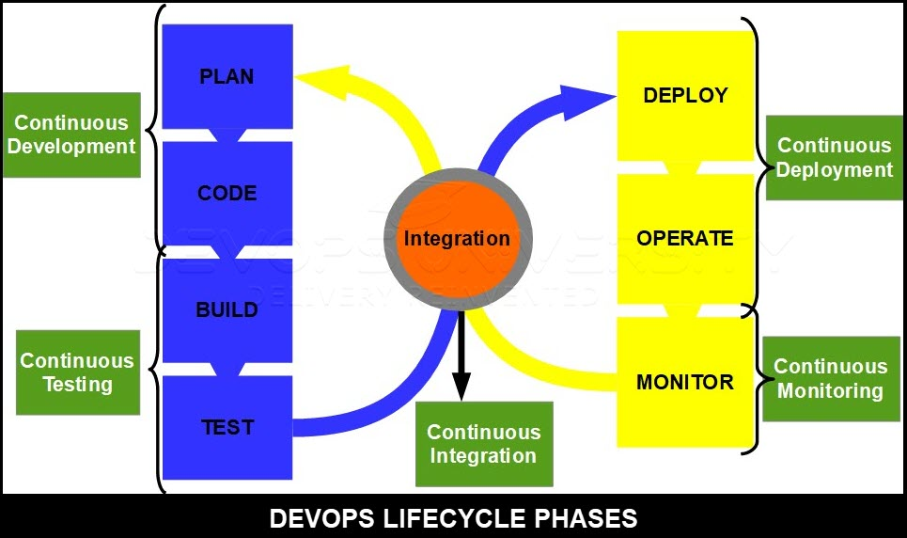
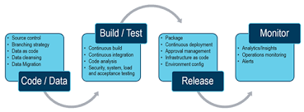
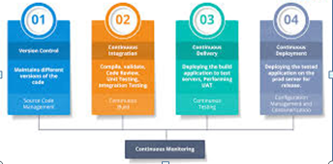
CI CD FLOW

Slide 14
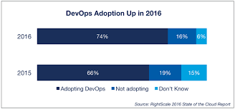
DEVOPS SCOPE
NEXGEN

Slide 15
THANK YOU

